Slide 1
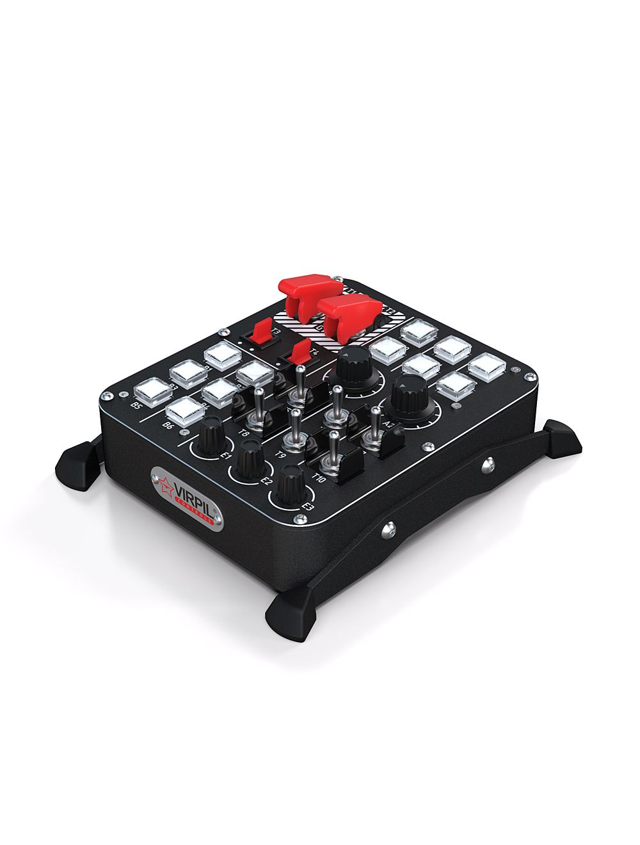



T2 (Up = Cover Open) | 16
T2 (Down = Cover Down) | 15
A1 Analog | Slider
T1 (Up = Cover Open) | 14
T1 (Down = Cover Down) | 13
B7 | 07
B8 | 08
B9 | 09
B10 | 10
B11 | 11
B12 | 12
T3 (left) | 17
T3( Right) | 18
T4 (Left) | 19
T4 (Right) | 20
B1 | 01
B2 | 02
B3 | 03
B4 | 04
B5 | 05
B6 | 06
A2 Analog | Dial
T5 – Up | 22
T5 – Down | 21
T6 – Up | 24
T6 – Down | 23
T7 – Up | 26
T7 – Down | 25
T8 – Up | 28
T8 – Down | 27
T9 – Up | 30
T9 – Down | 29
T-10 Up | 32
T-10 Down | 31
E1 – Counter-Clockwise | 35
E1 – Clockwise | 34
E1 – Press In | 33
E2 – Counter-Clockwise | 37
E2 – Clockwise | 38
E2 – Press In | 36
E3– Counter-Clockwise | 40
E3 – Clockwise | 41
E3 – Press In | 39
Plane
Title Here

