Slide 1
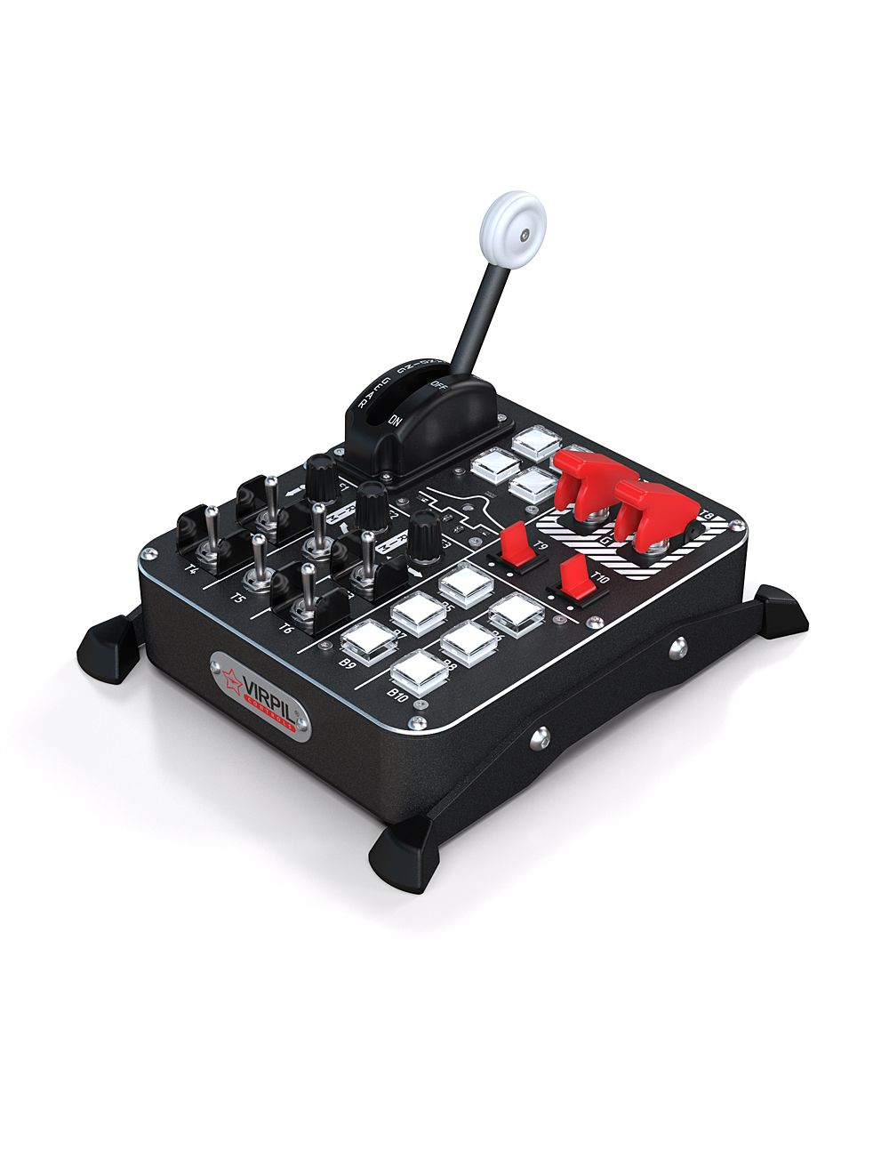



E3 – Counter-Clockwise | 38
E3 – Clockwise | 39
E3 – Press In | 37
B1 | 01
B2 | 02
B3 | 03
B4 | 04
E2 – Counter-Clockwise | 35
E2 – Clockwise | 36
E2 – Press In | 34
T7 (Up = Cover Open) | 24
T7 (Down = Cover Down) | 23
E1– Counter-Clockwise | 32
E2 – Clockwise | 33
E3 – Press In | 31
T8 (Up = Cover Open) | 26
T8 (Down = Cover Down) | 25
T5 – Up | 11
T5 – Down | 12
T6 – Up | 13
T6 – Down | 14
T7 – Up | 15
T7 – Down | 16
T8 – Up | 17
T8 – Down | 18
T9 – Up | 19
T9 – Down | 20
T-10 Up | 21
T-10 Down | 22
T9 (left) | 27
T9( Right) | 28
T10 (Left) | 29
T10 (Right) | 39
B5 | 05
B6 | 06
B7 | 07
B8 | 08
B9 | 09
B10 | 10
Plane
Title Here

