Slide 1
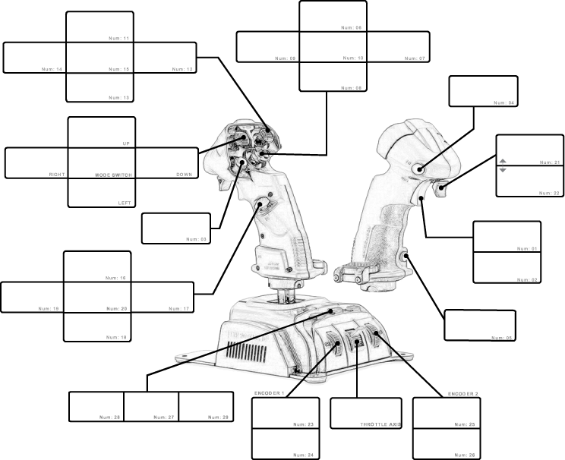
XXXX
XXXX
XXXX
XXXX
XXXX
XXXX
XXXX
XXXX
XXXX
XXXX
XXXX
XXXX
XXXX
XXXX
XXXX
XXXX
XXXX
XXXX
XXXX
XXXX
XXXX
XXXX
XXXX
XXXX
XXXX
XXXX
XXXX
XXXX
XXXX
XXXX
XXXX
XXXX
Plane
Title Here
XXXX
XXXX

Slide 2
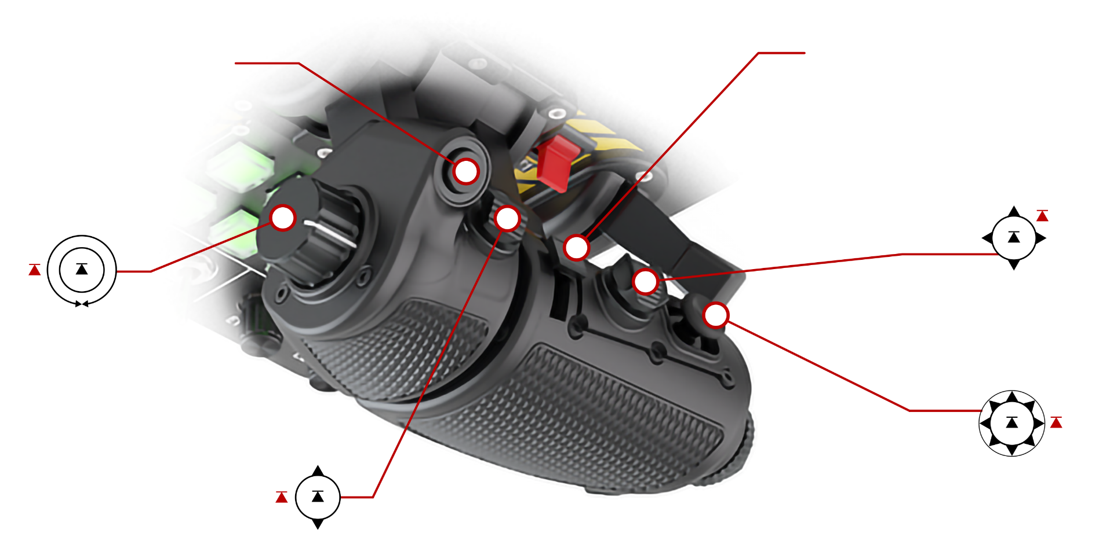
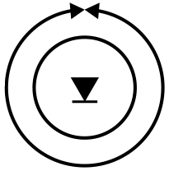



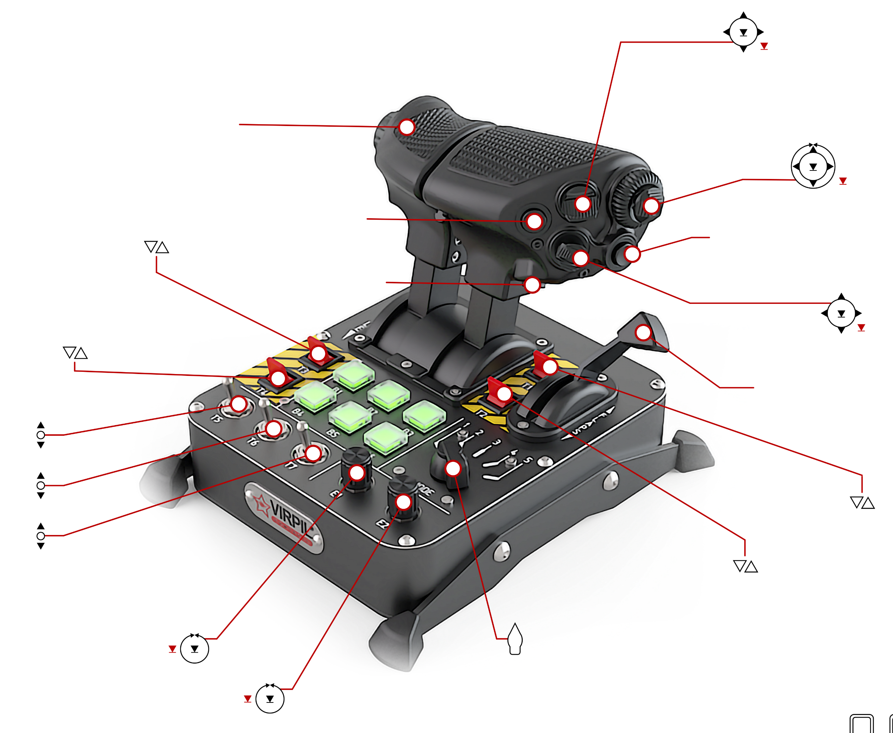





Roll Forward (C-CW) | 3
Roll Backward (CW) | 2
Press In | 1
4
FW/BW Analog (BW = Positive) | Z
L/R Analog | X
U/D Analog | Y
Press In | 13
Back (Up) | 11
FW (Down) | 9
Left | 12
Right | 10
Press In | 8
Right Throttle Forward/ Backward Analog | rY
Back (Up) | 7
Forward (Down) | 6
Press In | 5
Up | 25
Down | 23
Left/Back | 24
Right/ Forward | 26
Press In | 22
Left Throttle Forward/ Backward Analog | rX
T3 (Up = Button Pushed) | 36 63
T4 (Up = Button Pushed) | 37 64
Roll Forward | 14
Roll Backward | 15
Up | 20
Down | 18
Back | 19
Forward | 17
Press In | 16
32
T5 – Up | 44
T5 – Down | 45
T6 – Up | 46
T6 – Down | 47
T7 – Up | 48
T7 – Down | 49
33
21
E1 – Counter-Clockwise | 51
E1 – Clockwise | 52
E1 – Press In | 50
Mode Selector Switch
(Pages Through B1-B6 Buttons – See Next Page)
Up | 30
Down | 28
Left/Back | 29
Right/ Forward | 31
Press In | 27
T2 (Up = Button Pushed) | 35 62
E2 – Counter-Clockwise | 54
E2 – Clockwise | 55
E2 – Press In | 53
Plane
Title Here
T1 (Up = Button Pushed) | 34 61
Flaps Forward/ Backward Analog | rZ

Slide 3
Mode 1 (White):
B1 | 38 |  | B2 | 39 |  | B3 | 40
B4 | 41 |  | B5 | 42 |  | B6 | 43
Mode 2 (Blue):
B1 | 56 |  | B2 | 57 |  | B3 | 58
B4 | 59 |  | B5 | 60 |  | B6 | 61
Mode 3 (Green):
B1 | 62 |  | B2 | 63 |  | B3 | 64
B4 | 65 |  | B5 | 66 |  | B6 | 67
Mode 4 (Red):
B1 | 68 |  | B2 | 69 |  | B3 | 70
B4 | 71 |  | B5 | 72 |  | B6 | 73
Mode 5 (Yellow):
B1 | 74 |  | B2 | 75 |  | B3 | 76
B4 | 77 |  | B5 | 78 |  | B6 | 79
Plane
Title Here

