Slide 1
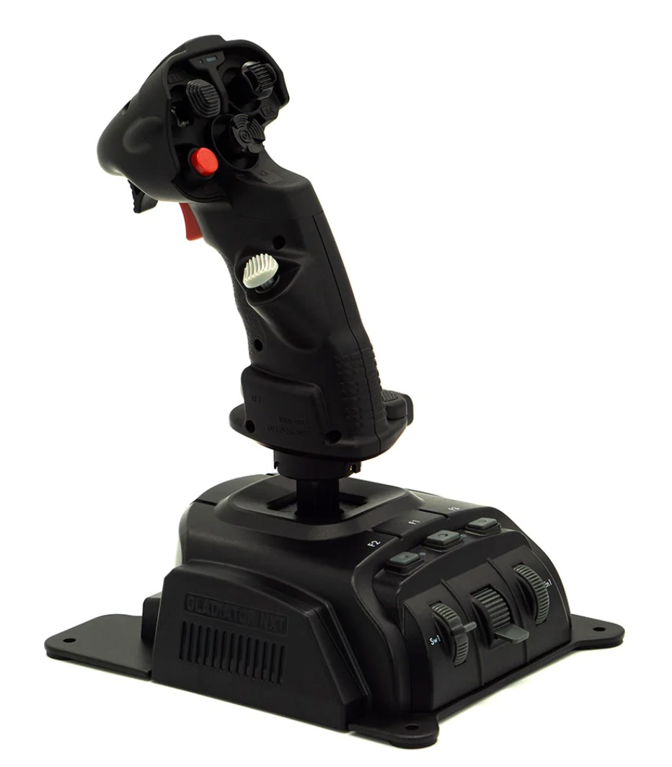
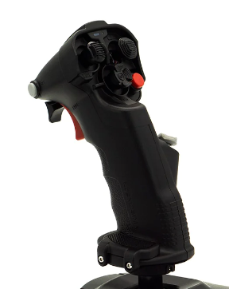
X &Y Saturation Curve: 25
SPARROW
[VKB SHIFT] DCS GAME TIME +++
TRIM UP
AMRAAM
UNDESIGNATE / ACM RESET /
NWS-HI (hold)
SIDEWINDER
TRIM LEFT
[VKB SHIFT] DCS Game Pause
TRIM RIGHT
TRIM DOWN
[VKB SHIFT] DCS GAME TIME NORMAL
CAGE / UNCAGE
VIEW slow UP
VIEW slow LEFT
DCS EASY COMMS <SPACE key Response>
VIEW slow RIGHT
VIEW slow DOWN
A2A GUN select
F10 THEATRE MAP VIEW
WEAPONS RELEASE
A2A GUN FIRE
F4 CHASE VIEW
NVR GOGGLES toggle
F6 WEAPON to TARGET VIEW
VR SPYGLASS ZOOM
[VKB SHIFT] BUTTON
DCS VR & CAMERA RESET
DCS ACTIVE PAUSE
DCS VR ZOOM
[VKB SHIFT] <ESCAPE key>
RIGHT MDI CONTRAST (FLIR)
NWS DISENGAGE
DCS EASY COMMS
<F1 KEY Response>
RWR INTENSITY ++ / --

Slide 2
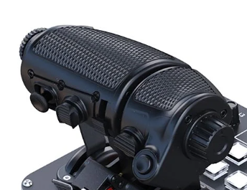
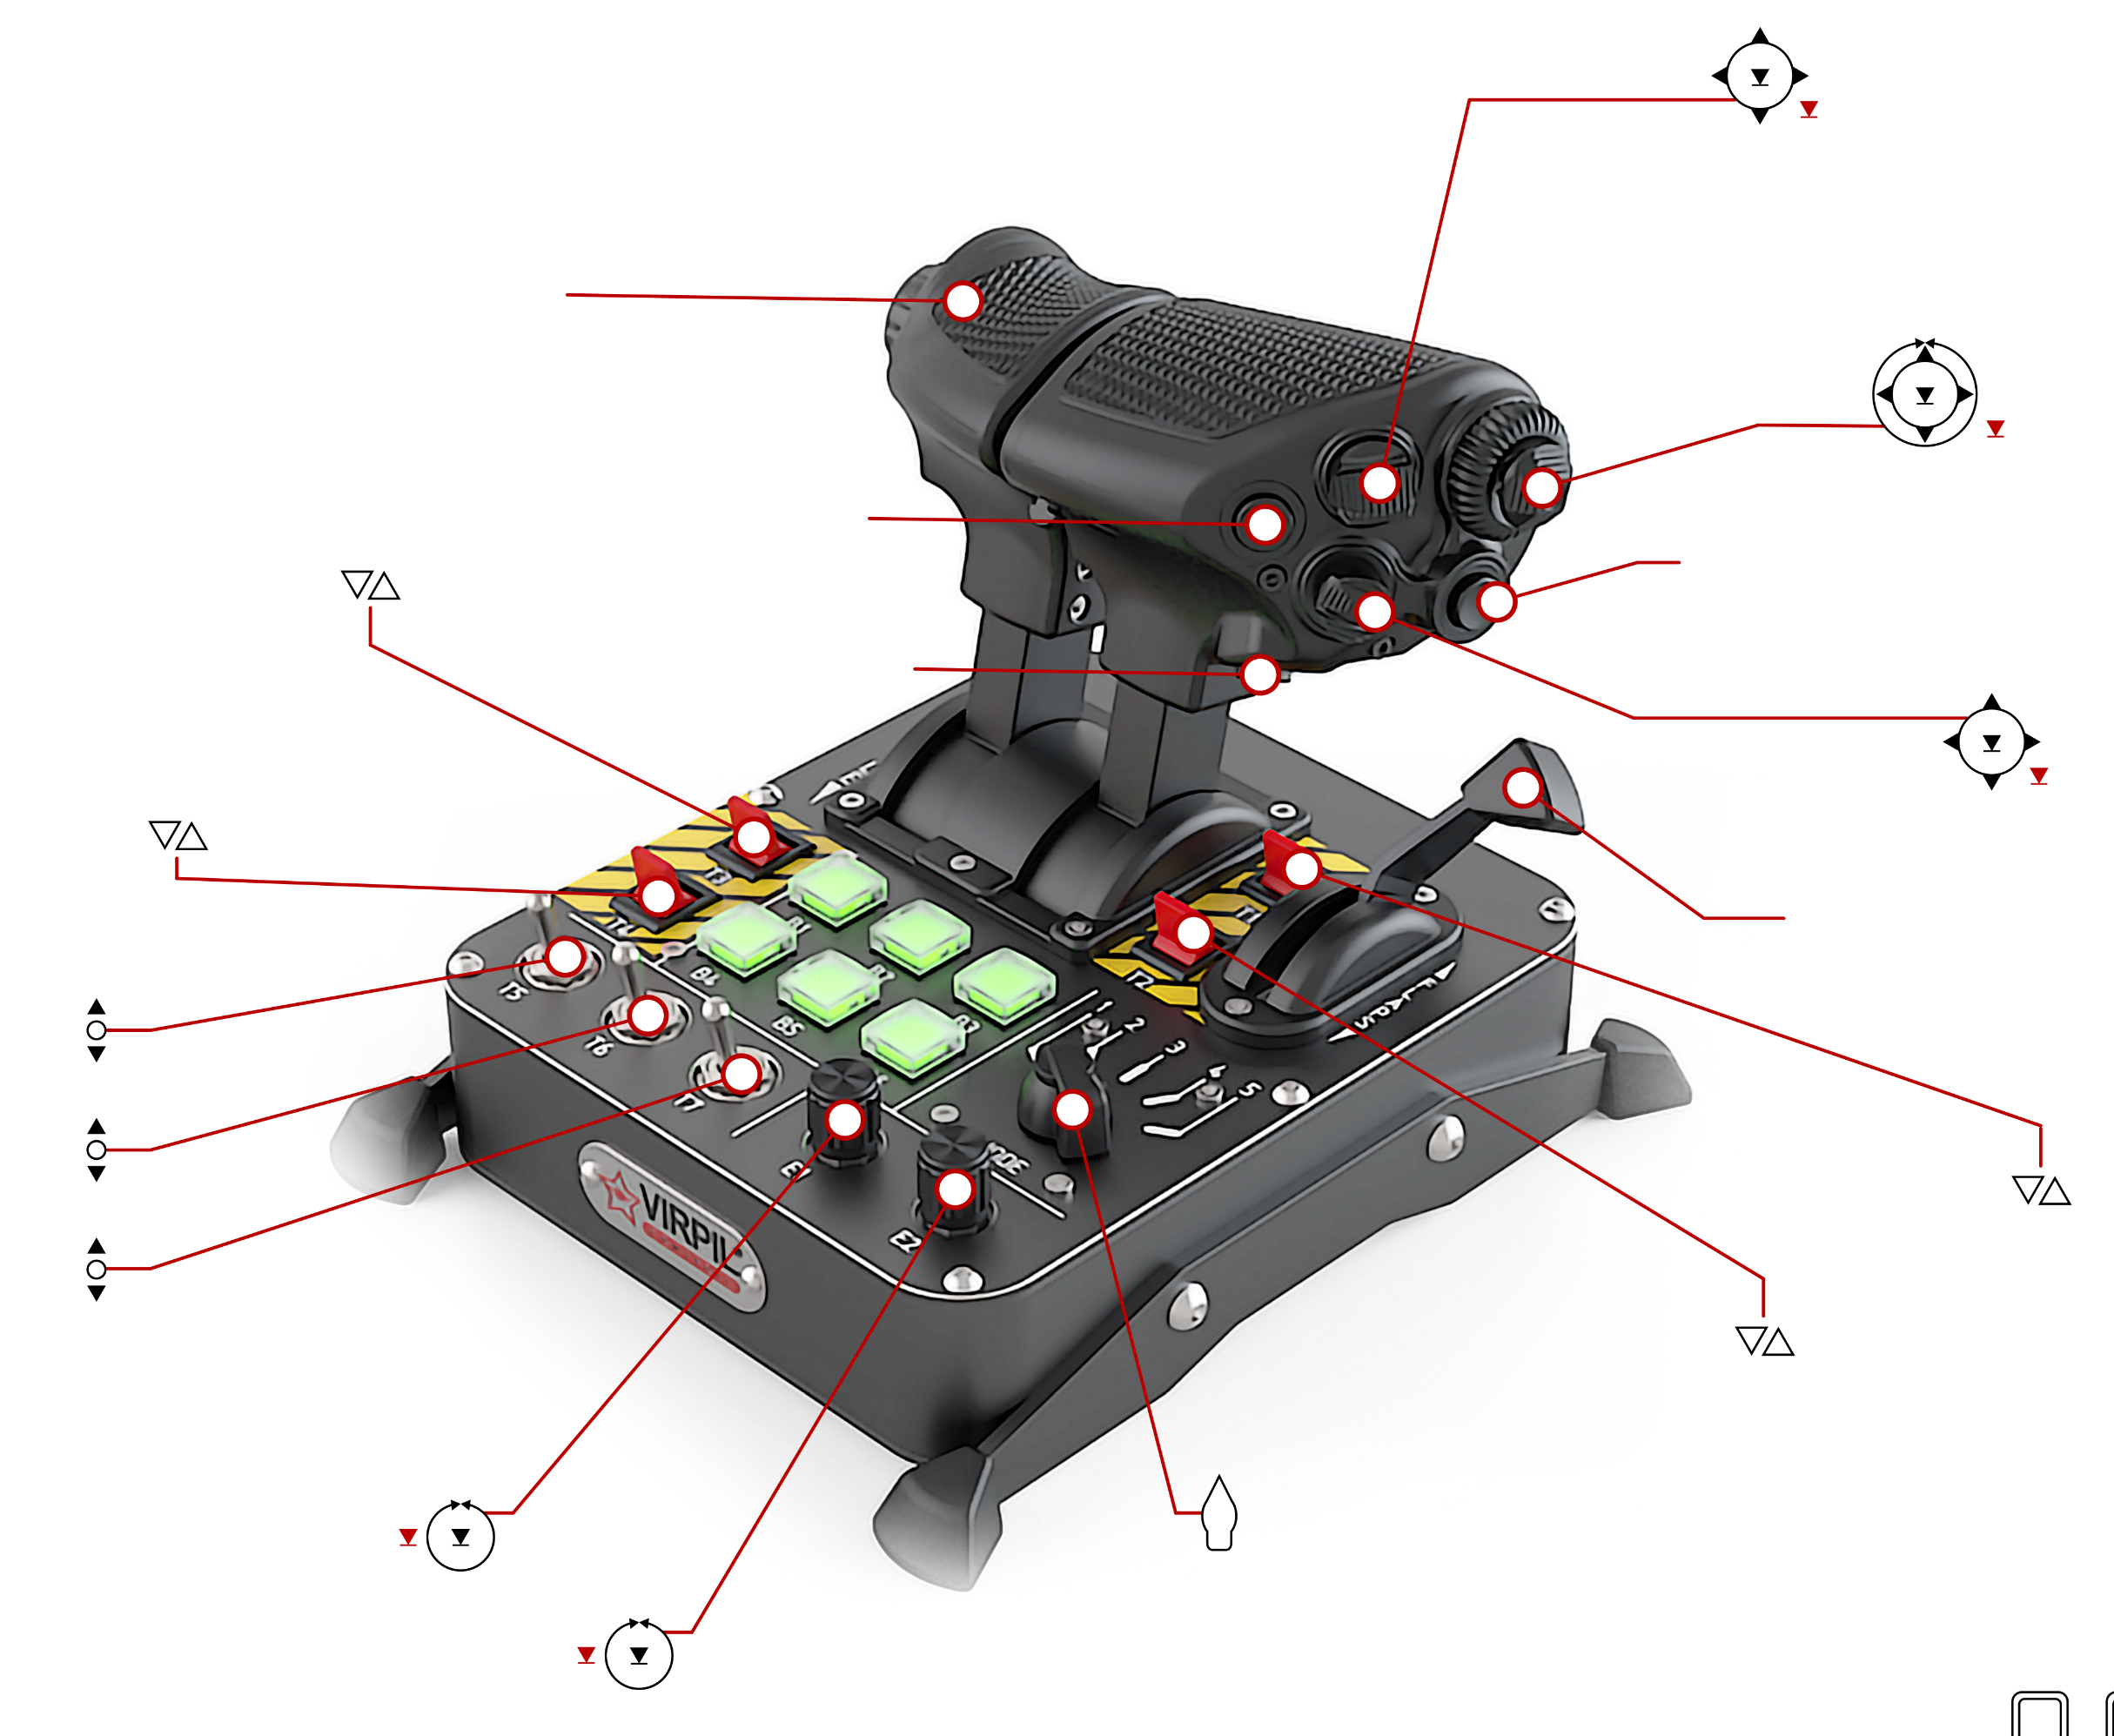




Roll Forward | Exterior View ZOOM +
Roll Backward | Exterior View ZOOM -
Press In | F2 Aircraft View
F1 COCKPIT VIEW
FW/BW Analog <AXIS to Buttons> | HMD Brightness
Back (Up) | SCS – UP (ACM in A2A-Mode)
FW (Down) | SCS – DOWN
Left | SCS – LEFT
Right | SCS – RIGHT
Press In | FENCE IN: Exterior Lights Switch - ON/OFF
L/R Analog | TDC Horizontal Slew
U/D Analog | TDC Vertical Slew
Press In | TDC DESIGNATE
Back (Up) | SPEED BRAKE UP (hold)
Forward (Down) | SPEED BRAKE RETRACT
Press In | FLASHLIGHT ON/OFF
Left/Back | KNEEBOARD PREVIOUS PAGE
Right/ Forward | KNEEBOARD NEXT PAGE
Up | Easy-COMMS Menu
Down | RAID
Press In | KNEEBOARD ON/OFF
T3 (UP ONLY) | DCS Labels Toggle <Switch Emulate>
L&R Idle&AB Physical-Detent Adjusted:
Deadzone: 10
SaturationX: 98
Inverted Slider
T4 (UP/DOWN) | LTD ARM/SAFE
Roll Forward | RADAR Elevation Control ++
Roll Back | RADAR Elevation Control --
Up | Right MDI 1 RADAR PRF MODE
Down | Right MDI 13 RADAR TWS AUTO/MAN Mode
Forward | Right MDI 11 RADAR RADAR Range ++
Back | Right MDI 12 RADAR RADAR Range --
Press In | Right MDI 5 RADAR TWS/RWS Mode
T5 – UP | CRS LEFT
T5 – DOWN | CRS RIGHT
T6 – UP | A2A Mode
T6 – DOWN | A2G Mode
T7 – UP | MASTER ARM/SAFE Toggle
T7 – DOWN | LANDING GEAR Toggle
WHEEL BRAKES
DISPENSE CMs
E1 – C-Clockwise | COMMS1 Channel --
E1 – Clockwise | COMMS1 Channel ++
E1 – Press In | COMMS1 Select
DCS VR ZOOM
Up | Right MDI FLIR Brightness ++
Down | Right MDI FLIR Brightness --
Forward | Right MDI 5 FLIR Zoom ++
Back | Right MDI 3 FLIR Zoom --
Press In | Right MDI 6 FLIR NAR/WIDE
E2 – C-Clockwise | COMMS2 Channel --
E2 – Clockwise | COMMS2 Channel ++
E2 – Press In | COMMS2 Select
5 Mode Selector Switch
(Next Page)
T1 UP/DOWN | CANOPY CLOSED CANOPY OPEN
T2 UP/DOWN | ALT RADAR ALT BARO
Axis 3-button | FLAPS – AUTO/HALF/FULL

Slide 3
Mode 1 (White): STARTUP
B1 | BATT ON | B2 | ENG CRANK LEFT | B3 | OBOGS ON
B4 | APU ON/OFF | B5 | ENG CRANK RIGHT | B6 | FCS RESET
Mode 2 (Blue): CARRIER TAKEOFF/LAND
B1 | LAUNCH BAR EXTEND/RETRACT | B2 | WINGS SPREAD Handle | B3 | HOOK UP/DOWN
B4 | ANTI SKID ON/OFF | B5 | WINGS STOW Handle | B6 | ‘Salute’
Mode 3 (Green): COMMS
B1 | Flight (Engage Bandits) | B2 | Flight (Attack AirDef) | B3 | Flight (Join Up)
B4 | Flight (Attack my Target) | B5 | Flight (Attack GroundDef) | B6 | F10 Menu (Switch Dialog)
Mode 4 (Red): UTILITY
B1 | DCS Framerate Counter | B2 | Fuel Probe Extend | B3 | Taxi Lights ON/OFF
B4 | RADAR STANDBY | B5 | Fuel Probe Retract | B6 | ‘Ready Pre-Contact’
Mode 5 (Yellow): OTHER
B1 | AMPCD PB12 (Next Waypoint) | B2 | UFC PB A/P | B3 | UFC Option PB3 (AP BALT)
B4 | AMPCD PB13 (Prev Waypoint) | B5 | UFC Option PB 5 (AP CPL) | B6 | ‘Call the Ball’

Slide 4
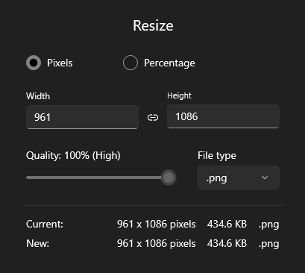
Paste Slide Page as-a- Image here & rescale/size for VR Kneeboard (e.g. right-click save-as-picture ../saved games/dcs/kneeboard)

Slide 5
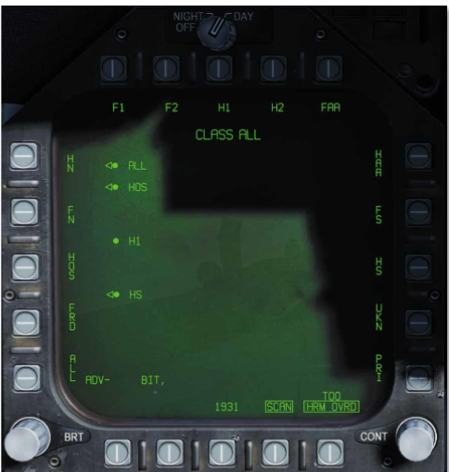
PBI 6 thru 10
PBI 5 thru 1
PBI 11 thru 15
PBI 16 thru 20

